Slide 1
IAEA Report
D. Abriola
Nuclear Data Section
Department of Nuclear Sciences and Applications
20th NSDD Meeting, Kuwait, January 2013

Slide 2
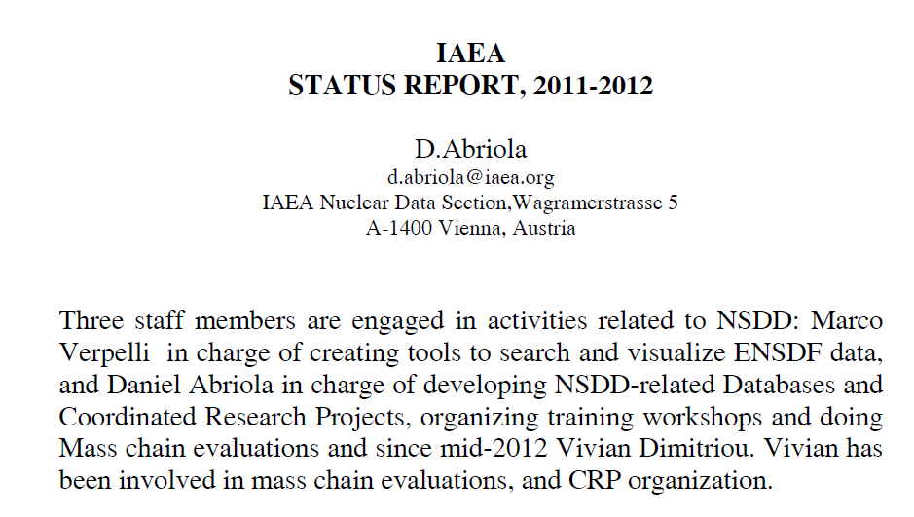

Slide 4
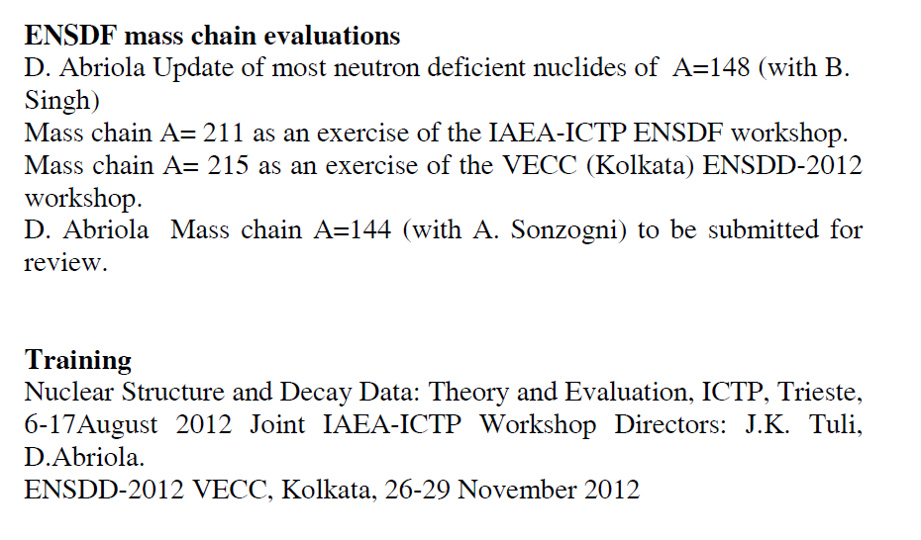

Slide 5
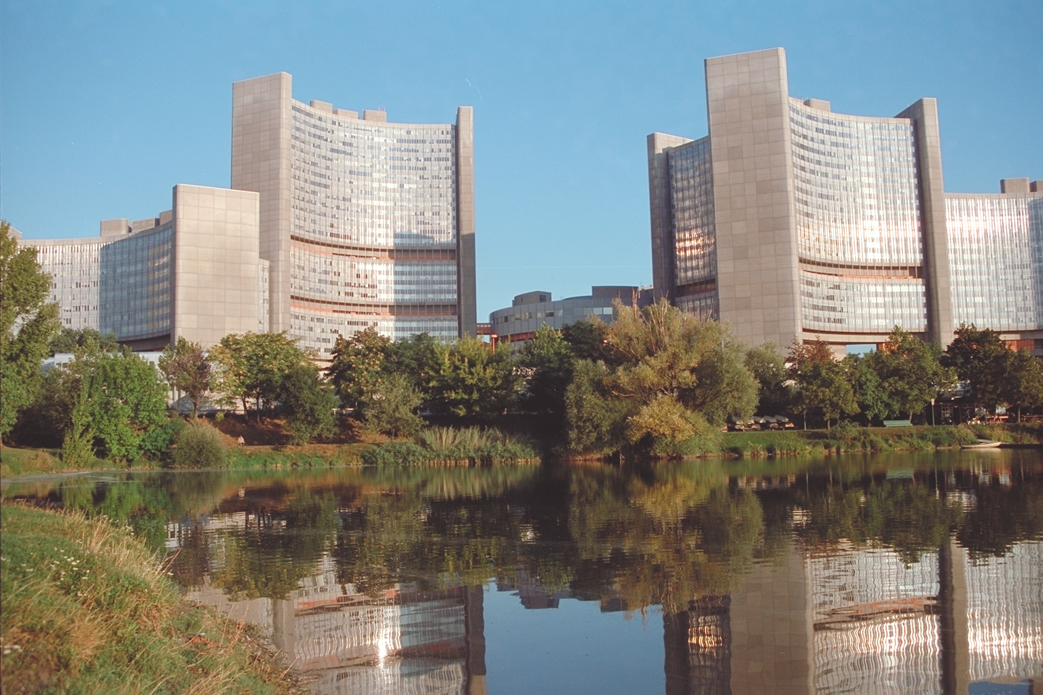
Thank you

